Slide 1
CIS 4526 Foundations of Machine Learning
Chapter 15
Deeper Dive of Deep Learning
References: Andrew Ng Lectures 8.1 to 8.7 and 9.1 to 9.4
Lecture 9.2 — Neural Networks Learning | Backpropagation Algorithm
Lecture 9.3 — Neural Networks Learning | Backpropagation Intuition

Slide 2
Outline
Neural Network
Notation, transformation, activation
Forward Propagation
Details computation
Backpropagation
Algorithm
Gradient Descent
Issues and Solutions

Slide 3
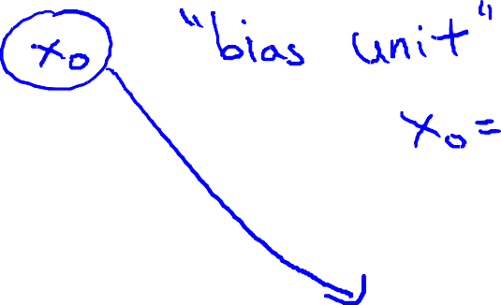
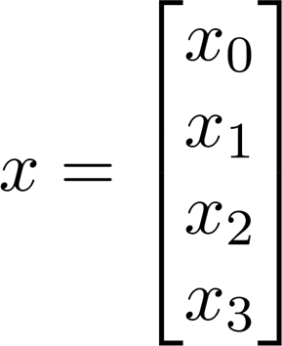
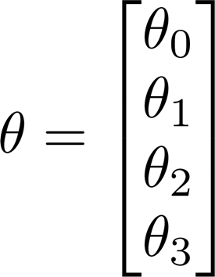
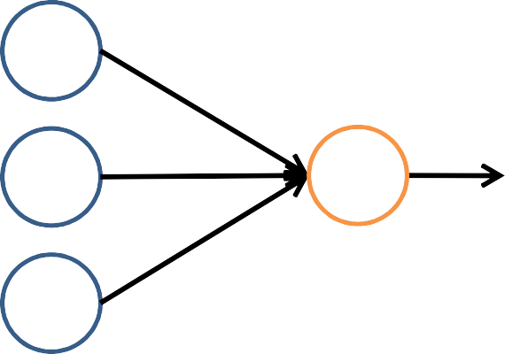
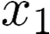
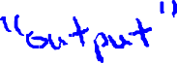

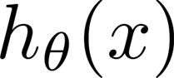
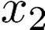
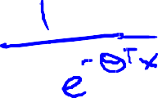



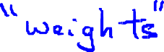
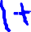

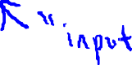
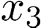
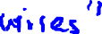







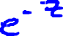
Neuron model: Logistic unit
Sigmoid (logistic) activation function.
Can choose a different activation function g(z) such as ReLu(z)

Slide 4
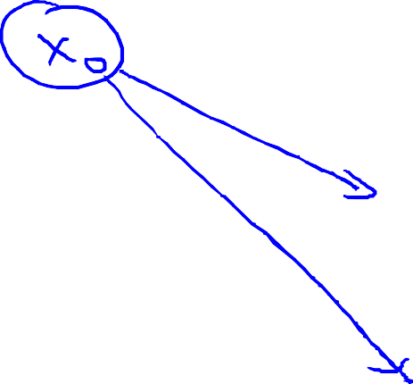
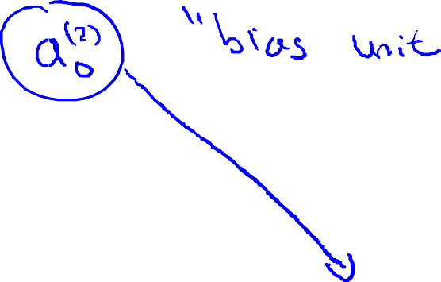

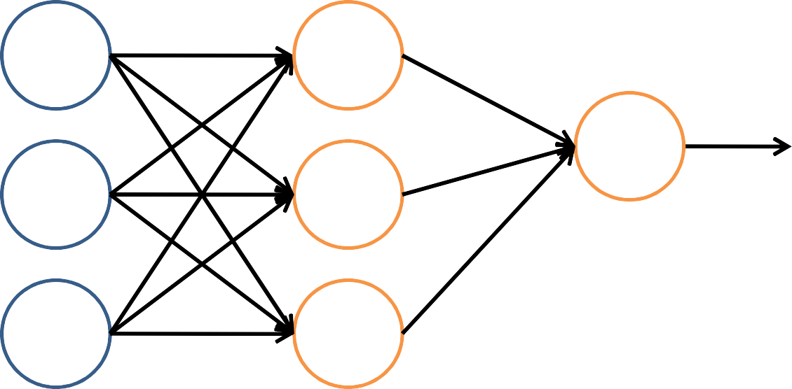
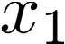
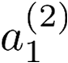

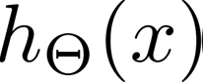
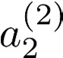
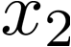




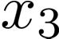
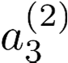

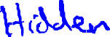
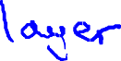
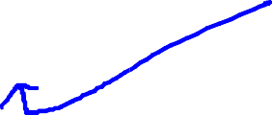
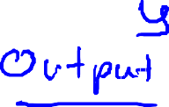
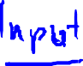

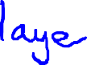

Neural Network
Layer 1
Layer 2
Layer 3

Slide 5




































Forward Propagation
input layer => 1st hidden layer =>2nd hidden layer …

Slide 6

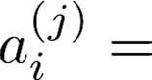

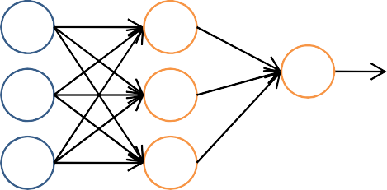
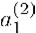
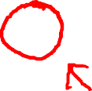
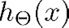

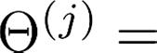
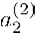

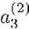
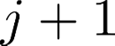

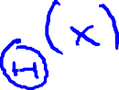
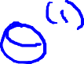
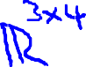
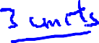


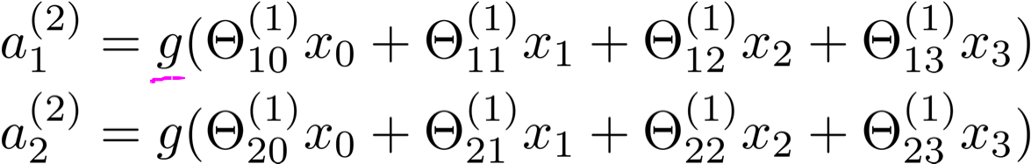

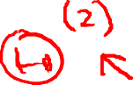




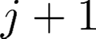
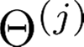
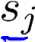
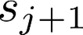






“activation” of unit in layer
matrix of weights controlling function mapping from layer to layer
If network has units in layer , will be of dimension
units in layer
, then
.
Andrew Ng

Slide 7




One-layer Neural Network using notation from the textbook
Fig 6.1
h(z) is the activation function which is the same as g(z) in previous notation
$W is the same as Θ$ = weights or model coefficients
b is the bias term which is the $W_{0}$

Slide 8











Two-layer Neural Network using notation from the textbook

Slide 9

Two-layer Neural Network using notation from the textbook

Slide 10






Vectorization over Units

Slide 11



Multi-layer Neural Network (forward propagation)
Eq. 6.10
Eq. 6.11

Slide 12














Vectorization over Data Points
We have so far just focus on one single data point. Let ignore h(x) and the bias term for easier notation

Slide 13












Vectorization over Data Points
We can stack the above equation for multiple inputs $x_{1}$, $x_{2}$ etc

Slide 14








Vectorization over Data Points
To summarize, we can vectorize over data points {$x_{i}\}_{i=1}^{n}$ where index i here is for the data point to be
=>These are the equations for forward propagation calculation

Slide 15


























For multi-class problem, need modification at the last output
Instead of
We need to apply softmax at the output layer

Slide 16


For multi-class problem, need modification at the last output

Slide 17

Training of the Neural Network
Training of the Neural Network means
Find the $W^{(i)}$ weights matrix, or the $Θ$so that the “error” is smallest

Slide 18
Outline
Neural Network
Notation, transformation, activation
Forward Propagation
Details computation
Backpropagation
Gradient Descent
(429) Lecture 9.2 — Neural Networks Learning | Backpropagation Algorithm — [ Machine Learning | Andrew Ng] - YouTube

Slide 19



Recall Cost function
Logistic Regression
Neural network

Slide 20











Gradient Computation
Need code to compute:

Slide 21













Gradient Computation
Given one training example (x, y):
Forward Propagation
Layer 1
Layer 2
Layer 3
Layer 4

Slide 22















Gradient Computation: Backpropagation Algorithm
Denote
“error” of node j in layer i
For each output unit (layer L=4)

Slide 23



















Backpropagation Algorithm (proof is complicated)
Training set
Set (for all ).
For
Set
Perform forward propagation to compute for Using , compute
Compute

Slide 24







Forward Propagation Example

Slide 25
















Forward Propagation
Andrew Ng

Slide 26

































Forward Propagation
“error” of cost for
(unit
in layer ).
Formally,
(for
), where

Slide 27

Backpropagation Algorithm Proof (use chain rule)
https://youtu.be/zUazLXZZA2U (Stanford Course 2018 in details)
https://youtu.be/yXcQ4B-YSjQ (Andrew Ng short video)

Slide 28
Outline
Neural Network
Notation, transformation, activation
Forward Propagation
Details computation
Backpropagation
Gradient Descent
Slides adapted from
WenPeng Yin Fall 2022 CIS 4526 Slides
Michail Michailidis (https://cs.brown.edu/courses/cs195w/slides/graddes.pdf)
Stanley Chan (https://engineering.purdue.edu/ChanGroup/ECE595/files/Lecture05_descent.pdf) Sham Kakade (https://courses.cs.washington.edu/courses/cse546/16au/slides/notes07.pdf) Christopher De Sa (https://www.cs.cornell.edu/courses/cs6787/2019fa/lectures/Lecture8.pdf) Fei-Fei Li (http://cs231n.stanford.edu/slides/2017/cs231n_2017_lecture7.pdf)

Slide 29
Gradient Descent in Linear Regression
Review the few slides in Chapter 7
Here we dive a little deeper

Slide 30




Partial Derivative
If we partially differentiate a function with respect to x, we pretend y is constant
Task: given
compute and

Slide 31

Partial Derivative – Tangent Plane
The two tangent lines that pass through a point, define a tangent plane to that point.

Slide 32

Gradient Vector
The vector that has as coordinates the partial derivatives of the function

Slide 33


Motivation of Gradient Descent
It is good for finding global minima/maxima if the function is convex
It is good for finding local minima/maxima if the function is not convex
It is used for optimizing many models in Machine Learning
❏ Neural Networks
❏ Linear Regression
❏ Logistic Regression
❏ Support Vector Machines
Convex function

Slide 34

Gradient Descent Algorithm and Walkthrough
Idea:
❏ start somewhere
❏ take steps based on the gradient vector of the current position till convergence
Convergence:
❏ happens when changes between two steps < ɛ
start point
look for a new direction
end point (minimum)

Slide 35




Gradient Descent Algorithm
Suppose we want to solve
In many machine learning problems, we have that L(w) is of the form
Gradient descent (GD):
t=0,1,2,3,…
⍺_{t} is called “step size” or “learning rate”

Slide 36

Potential Issues of Gradient Descent
In real world, we often cannot get convex function,
so we can only find local minimum

Slide 37


Potential Issues of Gradient Descent: Get stuck in local minimum
Bigger steps lead to faster convergence?

Slide 38
Potential Issues of Gradient Descent: Computationally Expensive
One practical difficulty is that computing the gradient itself can be costly, particularly when n is large.

Slide 39

Two Solutions
(2) adaptive learning rate
(1) use an approximation

Slide 40


Stochastic Gradient Descent
Most loss functions in machine learning problems are separable:
For example:
❏ Mean Square Error:
❏ Negative Log-likelihood Loss:

Slide 41


Stochastic Gradient Descent (SGD) Algorithm
Vanilla gradient descent:
main computation
The full gradient of the loss is
Stochastic gradient descent:
where B ⊆ {1, …, n} is a random subset; |B|=batch size

Slide 42
Stochastic Gradient Descent (SGD) Algorithm
Vanilla gradient descent:
main computation
The full gradient of the loss is
Stochastic gradient descent:
approximation
where B ⊆ {1, …, n} is a random subset; |B|=batch size

Slide 43

Stochastic Gradient Descent (SGD) Algorithm
❏ Given {(x_{i}, y_{i}) | i=1,...n}
❏ Initialize w
❏ For t =1,2,3,...
❏ Draw a random subset B ⊆ {1, …, n}
❏ Update
If |B| = 1, then use only one sample at a time.

Slide 44

Stochastic Gradient Descent (SGD) Algorithm
Online learning algorithm - Instead of going through the entire dataset on each iteration, randomly sample and update the model
❏ Given {(x_{i}, y_{i}) | i=1,...n}
❏ Initialize w
❏ For t =1,2,3,...
❏ Draw a random subset B ⊆ {1, …, n}
❏ Update

Slide 45
Perspectives of SGD
In convex problems, classical optimization literature have the following observations:
SGD offers a trade-off between accuracy and efficiency
More iterations
Less gradient computation per iteration
Noise is a by-product
Recent studies of SGD for non-convex problems (e.g., deep learning) found that
SGD for training deep neural networks works
SGD finds solution faster
SGD find a better local minima
Noise matters

Slide 46


SGD vs GD
Additionally, sampling the data in SGD leads to “noise” that can avoid finding “shallow local minima.” This is good for optimizing non-convex functions. (Kevin Murphy)

Slide 47
What is a good batch size |B| for SGD?
There is no definite answer.
❏ Look at the validation curve to determine if you need to increase/decrease the mini-batch size.
❏ Is typically chosen between 1 and a few hundreds (some people like 2^{x})
❏ Larger batch size means larger memory required. When you play huge neural networks, such as Transformers, you often do not have many choices due to the GPU memory limitation.

Slide 48

Adaptive Learning Rate

Slide 49
Adaptive Learning Rate
So far, we’ve looked at update steps that look like
❏ Here, the learning rate/step size is fixed a priori for each iteration.
❏ What if we use a learning rate that varies depending on the model?
❏ This is the idea of an adaptive learning rate.

Slide 50


Per-parameter Adaptive Learning Rate Schemes
Main idea: set the learning rate per-parameter dynamically at each iteration based on observed statistics of the past gradients.
There are many different schemes in this class

Slide 51
Adaptive Learning Rate
❏ AdaGrad (Duchi et al., 2011): Adaptive Gradient Algorithm
❏ RMSProp (Hinton et al., 2018): Root Mean Square Propagation
❏ Adam (Kingma and Ba, 2015): Adaptive Moment Estimation
❏ AdaDelta (Zeiler, 2012)
❏ SGD with Nesterov (Nesterov, 2013)

Slide 52
Appendix
(optional)
Just go to the last slide

Slide 53



AdaGrad: One of the first adaptive methods
Use history of sampled gradients to choose the step size for the next step
Algorithm AdaGrad
Input: initial learning rate ⍺, initial parameters w₀
initialize t ← 1
loop
sample a stochastic gradient
accumulate past gradients
update model: for all i ∈ {1, …, d}
t ← t+1
end loop

Slide 54
AdaGrad: One of the first adaptive methods
Use history of sampled gradients to choose the step size for the next step
Algorithm AdaGrad
Input: initial learning rate ⍺, initial parameters w₀
initialize t ← 1
loop
sample a stochastic gradient
accumulate past gradients
update model: for all i ∈ {1, …, d}
norm (or ”mean”) of the past gradients in the i-th parameter
t ← t+1
end loop

Slide 55
AdaGrad: One of the first adaptive methods
Use history of sampled gradients to choose the step size for the next step
Algorithm AdaGrad
Input: initial learning rate ⍺, initial parameters w₀
initialize t ← 1
loop
sample a stochastic gradient
accumulate past gradients
update model: for all i ∈ {1, …, d}
the actual step size is decreasing
t ← t+1
end loop

Slide 56

AdaGrad: One of the first adaptive methods
Use history of sampled gradients to choose the step size for the next step
Algorithm AdaGrad
Input: initial learning rate ⍺, initial parameters w₀
initialize t ← 1
loop
sample a stochastic gradient
accumulate past gradients
update model: for all i ∈ {1, …, d}
or
t ← t+1
end loop

Slide 57
Issue of AdaGrad
❏ What problems might arise when using AdaGrad for non-convex optimization?
❏ Think about the step size always decreasing. Could this cause a problem?
❏ If you do think of a problem that might arise, how could you change AdaGrad to fix it?

Slide 58


RMSProp
—Divide the gradient by a running average of its recent magnitude
Just replaces the gradient accumulation of AdaGrad, i.e.,
with an exponential moving average.
Algorithm RMSProp
Input: initial learning rate ⍺, initial parameters w₀ , weight ⍴
initialize t ← 1
loop
sample a stochastic gradient
accumulate past gradients
for all parameters
update model: for all i ∈ {1, …, d}
t ← t+1
end loop

Slide 59
—Divide the gradient by a running average of its recent magnitude
RMSProp
recent gradients will
Algorithm RMSProp
play a dominant role
Input: initial learning rate ⍺, initial parameters w₀ , weight ⍴
initialize t ← 1
loop
sample a stochastic gradient
accumulate past gradients
for all parameters
update model: for all i ∈ {1, …, d}
t ← t+1
end loop

Slide 60


Adam (biased version)
Algorithm Adam (biased version)
Input: initial learning rate ⍺, initial parameters w₀ , weight ⍴₁, ⍴₂
initialize t ← 1
loop
sample a stochastic gradient
accumulate past gradients in two ways:
and
update model: for all i ∈ {1, …, d}
t ← t+1
end loop

Slide 61

Adam (biased version)
Algorithm Adam (biased version)
Input: initial learning rate ⍺, initial parameters w₀ , weight ⍴₁, ⍴₂
initialize t ← 1
loop
sample a stochastic gradient
accumulate past gradients in two ways:
compared with RMSProp, the current gradient is replaced by an accumulation of past gradients
and
update model: for all i ∈ {1, …, d}
t ← t+1
end loop

Slide 62
Adam (biased version)
Algorithm Adam (biased version)
Input: initial learning rate ⍺, initial parameters w₀ , weight ⍴₁, ⍴₂
initialize t ← 1
loop
sample a stochastic gradient
accumulate past gradients in two ways:
Often called “momentum”: simply adds a fraction of the previous weight update to the current one
and
update model: for all i ∈ {1, …, d}
t ← t+1
end loop

Slide 63
Adam (biased version)
Algorithm Adam (biased version)
Input: initial learning rate ⍺, initial parameters w₀ , weight ⍴₁, ⍴₂
initialize t ← 1
loop
sample a stochastic gradient
accumulate past gradients in two ways:
and
update model: for all i ∈ {1, …, d}
Adam ≈ RMSProp with momentum
t ← t+1
end loop

Slide 64



Where does bias com from?
❏ Normally in practice ⍴₂ is set much closer to 1 than ⍴₁ (as suggested by the author ⍴₂=0.999, ⍴₁=0.9), so the update coefficients 1−⍴₂=0.001 is much smaller than 1−⍴₁=0.1.
❏ In the first step of training , , t ; the
term in the parameter update can be very large if we use the biased version directly.

Slide 65


Adam (unbiased version)
Algorithm Adam (unbiased version)
Input: initial learning rate ⍺, initial parameters w₀ , weight ⍴₁, ⍴₂
initialize t ← 1
loop
sample a stochastic gradient
accumulate past gradients in two ways:
and
debias by
and
update model: for all i ∈ {1, …, d}
t ← t+1
end loop
50

Slide 66
Is bias correction really a big deal?
❏ Since it only actually affects the first few steps of training, it seems not a very big issue;
❏ In the early versions of many popular frameworks (e.g. keras, caffe) only the biased version was implemented.

Slide 67

Which Adaptive Learning Rate Method Works Best?
Adam has been widely used as the default State-Of-The-Art (SOTA) tech to train deep learning systems.

